Slide 1
Data Presentation
Sutton Middle School

Slide 2
Overall Scores Compared to District Scores
Reading Scores Compared to District Scores
Math Scores Compared to District Scores

Slide 3
MAP All Students, All Student Groups

Slide 4
MAP 6th Grade Reading by Student Groups
White
Black
Hispanic
SWD
EL

Slide 5
MAP 6th Grade Math by Student Group
White
Black
Hispanic
SWD
EL

Slide 6
7th Grade Reading by Student Group
White
Black
Hispanic
SWD
EL

Slide 7
MAP 7th Grade Math by Student Group
White
Black
Hispanic
SWD
EL

Slide 8
MAP 8th Grade Reading by Student Group
White
Black
Hispanic
SWD
EL

Slide 9
MAP 8th Grade Math by Student Group
White
Black
Hispanic
SWD
EL

Slide 10
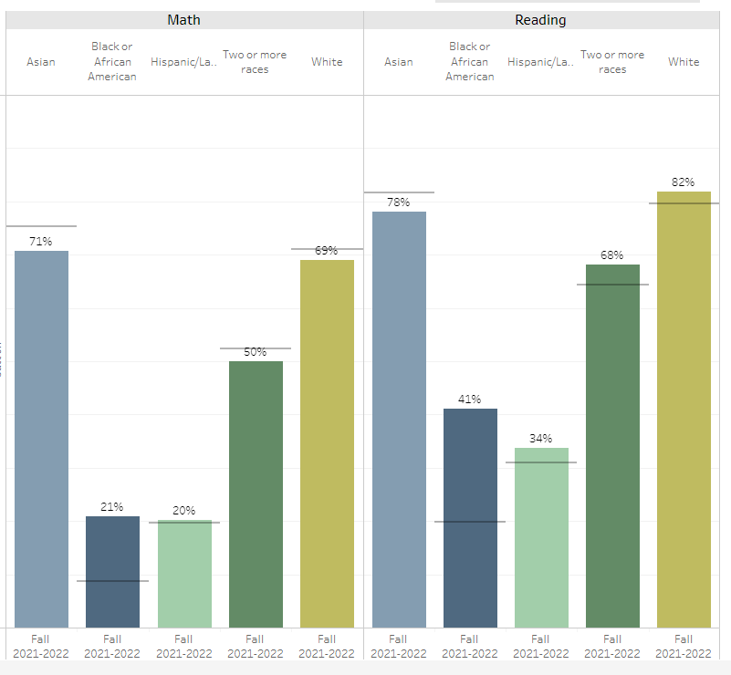
Comparison of MAP Scores by Ethnicity

Slide 11
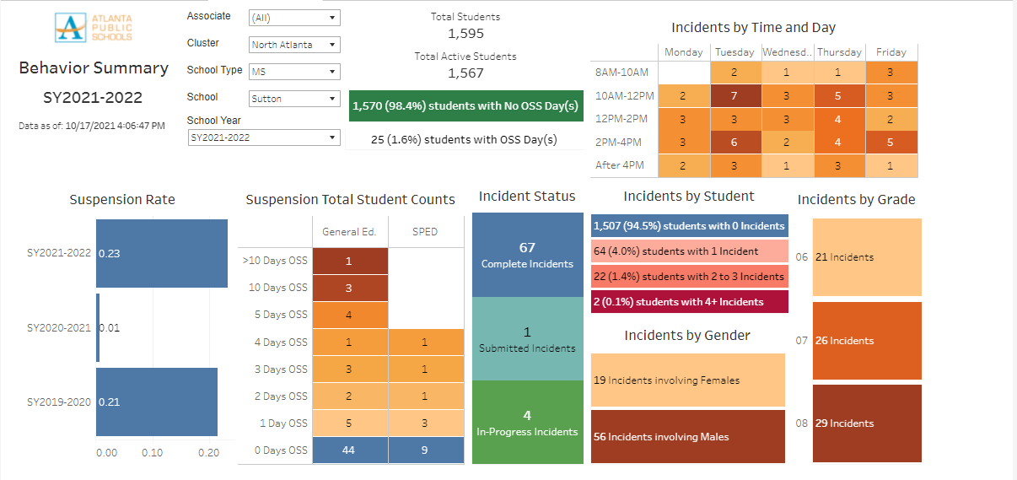
Behavior Incidents at Sutton

